Slide 1


Slide 2
Lecture : 04
Introduction to Html

Slide 3
What is html?
HTML stands for HyperText Markup Language.
It is the standard language used to create and structure web pages.
HTML is not a programming language, it is a markup language.
Role in Web Development:
HTML forms the foundation of a website.
CSS (Cascading Style Sheets) is used to style the HTML.
JavaScript is used to make the HTML interactive.

Slide 4
HTML is the Foundation of Every Website
HTML (HyperText Markup Language) provides the basic structure of a web page.
HTML allows:
Sending form data to a server
Connecting to databases through backend systems
Displaying dynamic content
Screen readers understand content
Visually impaired users access websites
Proper content organization

Slide 5
Structure of an HTML Document
A proper HTML document has three main parts:
<!DOCTYPE html>
Declares the HTML version for the browser.
Example:
<!DOCTYPE html>
Explains that this is an HTML5 page.

Slide 6
Cont…
<html> element
The root element of an HTML document.
All content of the page goes inside <html> and </html> tags.
<html>
<!-- All page content here -->
</html>

Slide 7
Cont…
<head> section
Contains metadata and information not visible directly on the web page.
Typical elements inside <head>:
Tag | Purpose
<title> | Page title shown on browser tab
<meta> | Metadata like character set and viewport settings
<link> | Link to external CSS files
<script> | Link to external JavaScript files

Slide 8
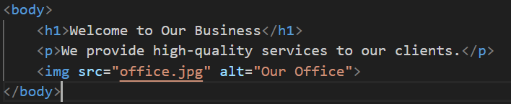
Cont…
<body> section
Contains all content visible on the web page.
Examples of content inside <body>:
Headings <h1> to <h6>
Paragraphs <p>
Images <img>
Lists <ul>, <ol>
Forms <form>

Slide 9
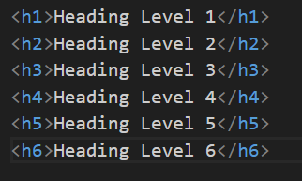
Headings in HTML
Headings are used to define titles and subtitles on a webpage.
HTML provides 6 levels of headings:

Slide 10
Paragraphs in HTML
Paragraphs are used to write text content.
Syntax: <p>This is a paragraph.</p>
Example: <p>We provide high-quality marketing solutions to grow your business.</p>
Each <p> creates a new paragraph.
Browser automatically adds space above and below.
Used for descriptions, company information, product details.

Slide 11

Links in HTML
Links connect one page to another or connect to external websites.
Syntax: <a href="URL">Link Text</a>
<a> = Anchor tag
href = Destination address
Example 1: External Website

Slide 12

Cont…
Example 2: Internal Page
Example : Open in New Tab:

Slide 13
Images in html
Images are displayed using <img> tag.
Syntax: <img src="image.jpg" alt="Description">
Important Attributes
Attribute | Purpose
src | Image file path
alt | Description if image does not load
width | Width of image
height | Height of image

Slide 14
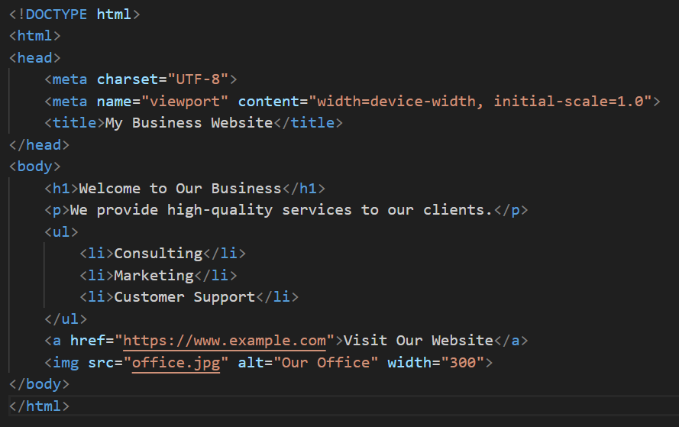
Complete html document

Slide 15
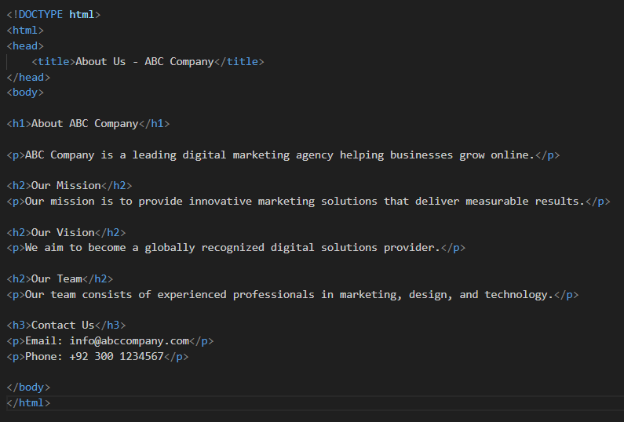
Creating business content pages

Slide 16
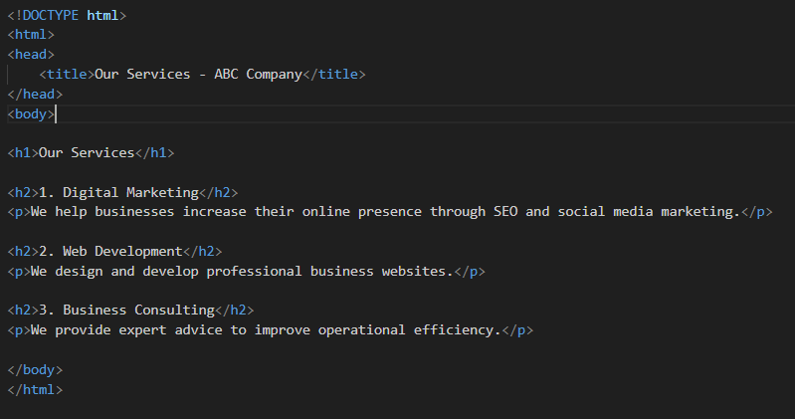
Services section in html

Slide 17
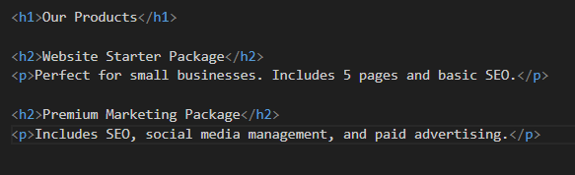
Products section using list

Slide 18
What is an HTML Form?
An HTML Form is used to collect information from users.
Businesses use forms to:
Collect customer data
Receive messages
Take online orders
Register users
Conduct surveys
Forms send data to a server for processing.

Slide 19

Basic Structure of a Form
<form> - Defines the form
action - Where the data will be sent
method - How the data will be sent
GET - Data visible in URL
POST - Data hidden (used for sensitive info)
Always use POST for login, payments, and customer data.

Slide 20
Input fields
Input fields allow users to enter different types of information.
The main tag is <input type="...">
Text Input
Used for names, city, etc.

Slide 21

Cont…
Email Input
Automatically checks valid email format
Useful for customer communication
Password Input
Used for Login forms
Account creation

Slide 22


Cont…
Number Input
Used for Product quantity
Phone number (sometimes)
Date Input
Used for Appointment booking
Delivery scheduling

Slide 23


Cont…
Radio Buttons (Choose One)
Used for Payment method selection
Delivery type
Checkboxes (Multiple Selection)
Used for Skills selection
Newsletter subscription

Slide 24

Cont…
Textarea (Large Text Box)
Used for Customer message
Feedback
Reviews
Rows = 4 means the user can see 4 lines of text without scrolling.
Cols = 30 means approximately 30 characters fit in one line.

Slide 25
Buttons in Forms
Buttons allow users to submit or reset the form.
Submit Button
<button type="submit">Submit</button>
Or
<input type="submit" value="Send">
Reset Button
Purpose : Clear all fields <button type="reset">Reset</button>

Slide 26
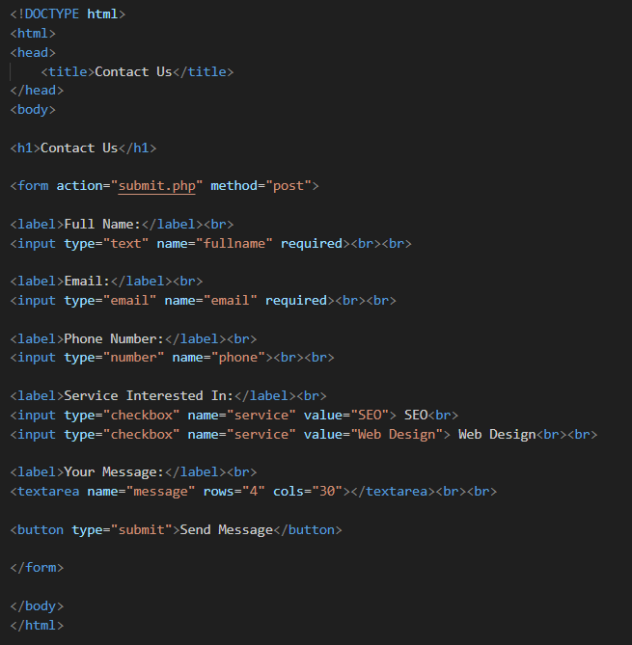
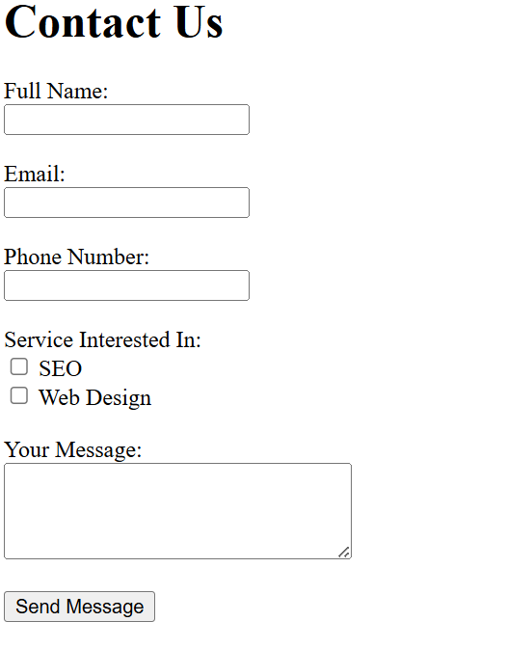
Contact Us Form with output

